Slide 1

UDPS 2133 Mathematical Programming
Topic 3:
Deterministic Dynamic Programming

Slide 2
Deterministic Dynamic Programming
Network Problem
Inventory Problem
Resource Allocation Problem
Knapsack Problem
Equipment Replacement Problem
Travelling Salesman Problem
Additive Recursion
Non-additive Recursion
Minimax Shortest Route
Sales Allocation
Wagner-Whitin Algorithm
Dynamic Lot-Size Model
Silver-Meal Heuristic

Slide 3
Dynamic Deterministic Programming?
Dynamic Programming is a general algorithm design technique for solving problems defined by recurrences with overlapping subproblems.
Invented by American mathematician Richard Bellman in the 1950s to solve optimization problems.
“Programming” here means “planning”.
Main idea:
Set up a recurrence relating a solution to a larger instance to solutions of some smaller instances
Solve smaller instances once
Record solutions in a table
Extract solution to the initial instance from that table

Slide 4
Examples – Puzzles
Suppose there are 30 cards on a table. I begin by picking up 1, 2, or 3 cards. Then my opponent must pick up 1, 2, or 3 cards. We continue in this fashion until the last card is picked up. The player who picks up the last match is the loser. How can I (the first player) be sure of winning the game?
To win:- ensure that it will be my opponent’s turn when 1 match remains
Work backward: ensure that it will be my opponent’s turn when 5 matches remain.

Slide 5
Examples – Puzzles
If I can force my opponent to play when 5, 9, 13, 17, 21, 25, or 29 cards remain, I am sure of victory.
∴I cannot lose if I pick up 30 − 29 = 1 card on my first turn.
Then I simply make sure that my opponent will always be left with 29, 25, 21, 17, 13, 9, or 5 matches on his turn.

Slide 6
Examples – Milk (6 oz)
9-oz
9-oz
9-oz
9-oz
9-oz
4-oz
4-oz
4-oz
4-oz
4-oz
4-oz
4-oz
9-oz
0-oz
5-oz
4-oz
5-oz
0-oz
1-oz
4-oz
9-oz
9-oz
9-oz
4-oz
1-oz
9-oz
9-oz
3-oz
4-oz
4-oz
4-oz
4-oz
1-oz
0-oz
0-oz
1-oz
6-oz
4-oz
9-oz
1-oz

Slide 7
Examples – Milk (6 oz)
9-oz
9-oz
9-oz
9-oz
9-oz
4-oz
4-oz
4-oz
4-oz
4-oz
4-oz
4-oz
9-oz
0-oz
5-oz
4-oz
5-oz
0-oz
1-oz
4-oz
8-oz
9-oz
9-oz
1-oz
9-oz
9-oz
3-oz
4-oz
4-oz
4-oz
4-oz
1-oz
1-oz
0-oz
6-oz
9-oz
1-oz

Slide 8
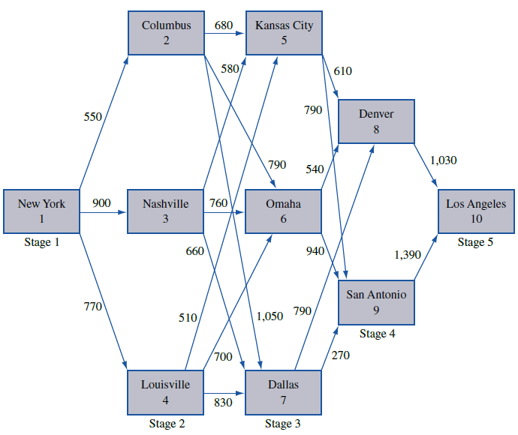
Network Problem / Shortest Path
Find the shortest (or longest) path that joins 2 points in a network.
NY → LA, minimize the number of miles traveled, where should Joe spend each night of the trip?

Slide 9
Stage 3: The shortest from 5→8→10, not 5→9→10
Stage 3: The shortest from 6→8→10
Stage 4: The shortest from 8→10
Stage 4: The shortest from 9→10
Stage 3: The shortest from 7→9→10, not 7→8→10

Slide 10



Manual writting
Stage 4: City 8 City 9
Stage 3: City 5, 6 and 7 To City 8 or 9 reach City 10

Slide 11
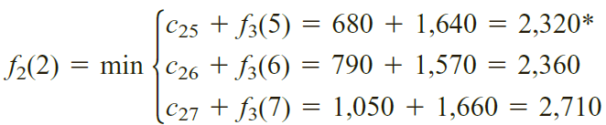
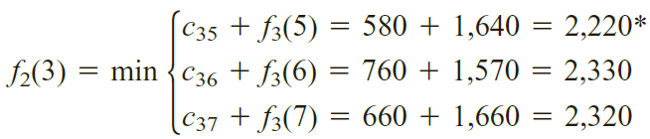
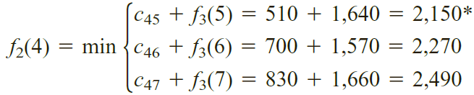
Stage 2: City 2, 3 and 4 To City 5, 6 or 7 reach City 10

Slide 12
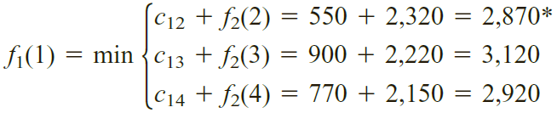
Stage 1: City 1 To City 2, 3 or 4 reach City 10
∴Shortest path: start from City 1(NY), to City 2(Columbus), then to City 5(Kansas City), City 8(Denver) and reach City 10(LA) with 2870 miles.

Slide 13
Dynamic Programming
Characteristic:
Problem divided into Stages with decision required at each stage.
Each stage has # of States (choices) associated with it.
The Decision chosen at any stage describes how the state at current stage is transformed into the other state in next stage.
Principle of Optimality: Given the current state, the optimal decision for each of the remaining stages must not depend on previously reached states or previously chosen decisions.

Slide 14
Dynamic Programming
Characteristic:
Recursion formalizes the working-backward procedure.
Optimal choice chosen from future stage
Current stage
Current state
Reward earn / cost incur from state i (current state) to state j (future state)

Slide 15
Inventory Problem
Inventory problem characteristics:
Time is broken up into periods (1, 2, …, T). At the beginning of period 1, the demand during each period is known.
At the beginning of each period, must determine how many units to be produced as production capacity during each period is limited.
Each period’s demand must be met on time from inventory or current production. Fixed cost of production, a variable per-unit cost is incurred.
A per-unit holding cost is incurred on each period’s ending inventory as storage capacity is limited.
The goal is to minimize the total cost by meeting the demands on time for all periods.

Slide 16
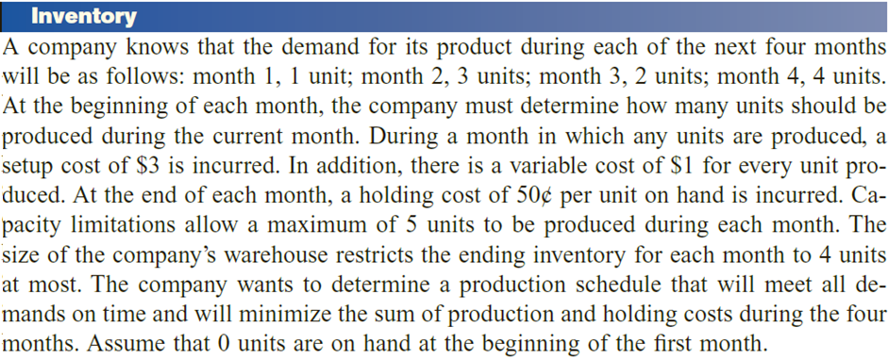
Month, t | Demand
1 | 1
2 | 3
3 | 2
4 | 4
f_{t}(i) = minimum cost of meeting demands for month t = 1 to 4 if i units are on hand at the beginning of month t.
c(x) = cost of producing x unit
c(0) = 0, c(x) = 3 + 1x
Possible stage (month): 1, 2, 3, 4
Possible state (stock on hand): 0, 1, 2, 3, 4

Slide 17
Inventory Problem
Stage 4:
f₄(i): production cost, c(x) (demand – i unit on hand)
x₄(i) = x product to be produced at stage 4 with i product on hand
f₄(0): 3 + 4 = 7 ; x₄(0) = 4
f₄(1): 3 + 3 = 6 ; x₄(1) = 3
f₄(2): 3 + 2 = 5 ; x₄(2) = 2
f₄(3): 3 + 1 = 4 ; x₄(0) = 1
f₄(4): 0 + 0 = 0 ; x₄(0) = 0

Slide 18
Inventory Problem
f₄(0): 3 + 4 = 7
f₄(1): 3 + 3 = 6
f₄(2): 3 + 2 = 5
f₄(3): 3 + 1 = 4
f₄(4): 0 + 0 = 0
Stage 3:
f₃(i): min_{x} {c(x) + 0.5×(i + x – 2) + f₄(i + x – 2) }
Production cost + holding cost + stage 4 cost with i + x – 2 holding unit
f₃(0): min produce 2 unit (due to demand of 2)
produce 3 unit (demand 2 and 1 holding stock)
produce 4 unit (demand 2 and 2 holding stock)
max produce 5 unit (demand 2 and 3 holding stock)
⁞
f₃(4): produce 0 unit (4 stock on hand, demand 2, 2 holding s.)
produce 1 unit ( ‖ , demand 2 and 3 holding s.)
produce 2 unit ( ‖ , demand 2 and max 4 holding s.)

Slide 19
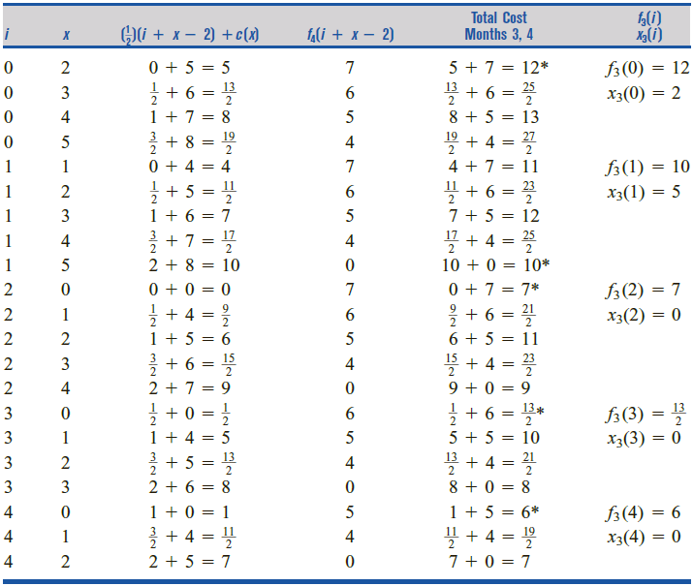

On hand
produce
cost
Stage 4
f₃(0) =
Production cost = Setup cost + variable cost
Produce 2 unit cost = 3 + 1(2) = 5
Holding cost = 0.5 × (stock produced – demand )
2 stock on hand = 0.5( 4 + 0 − 2 ) = 1
f₃(4) =
Total cost = production cost + holding cost
4 stock on hand + produce 2 stock : 0.5(4+2−2)+[3+1(2)]
f₃(4) =

Slide 20
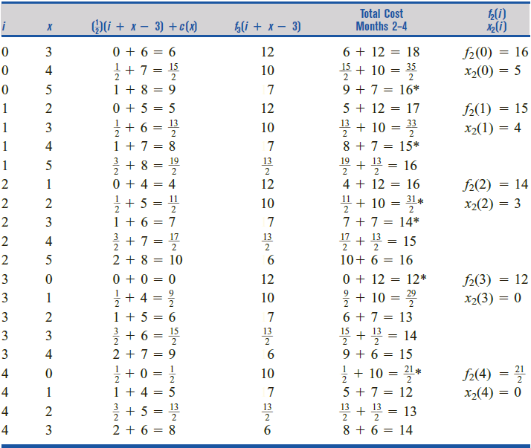
Stage 2: f₂(i): min_{x} {c(x) + 0.5×(i + x – 3) + f₃(i + x – 3) }

Slide 21
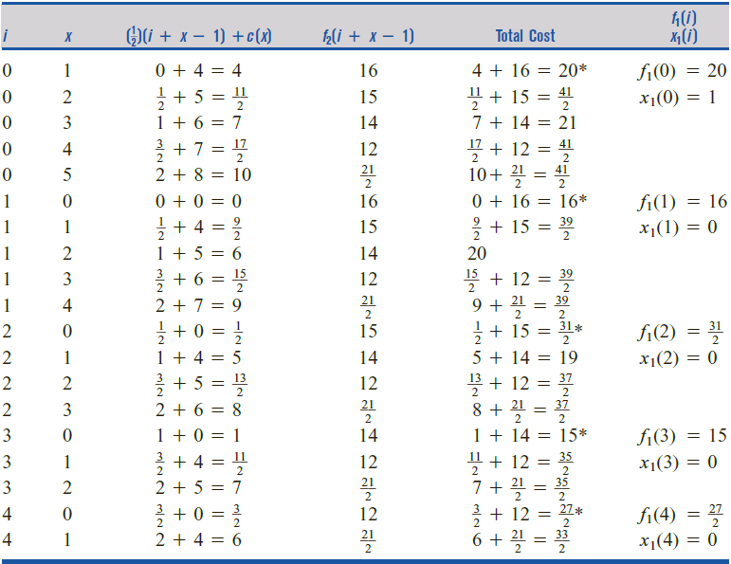
Stage 1: f₁(i): min_{x} {c(x) + 0.5×(i + x – 1) + f₂(i + x – 1) }

Slide 22
Resource-Allocation Problems
State
stage
Finco has $6,000 to invest, and 3 investments are available. If d_{j} dollars (in thousands) are invested in investment j, then a net present value (in thousands) of r_{j}(d_{j}) is obtained, where the r_{j}(d_{j})’s are as follows:
r₁(d₁) = 7d₁ + 2 (d₁ > 0)
r₂(d₂) = 3d₂ + 7 (d₂ > 0)
r₃(d₃) = 4d₃ + 5 (d₃ > 0)
r₁(0) = r₂(0) = r₃(0) = 0 (d3
The amount placed in each investment must be an exact multiple of $1,000. To maximize the net present value obtained from the investments, how should Finco allocate the $6,000?

Slide 23
Resource-Allocation Problems
max { r₁(d₁) + r₂(d₂) + r₃(d₃) }
s.t. d₁ + d₂ + d₃ = 6 , d_{j} > 0 for j = 1, 2, 3
Stage 3: Invest on only r₃(d₃) = 4d₃ + 5
f₃(0) = 0 x₃(0) = 0
f₃(1) = 9 x₃(1) = 1
f₃(2) = 13 x₃(2) = 2
f₃(3) = 17 x₃(3) = 3
f₃(4) = 21 x₃(4) = 4
f₃(5) = 25 x₃(5) = 5
f₃(6) = 29 x₃(6) = 6

Slide 24
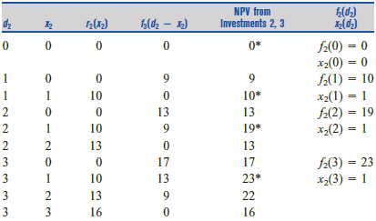
Resource-Allocation Problems
max { r₁(d₁) + r₂(d₂) + r₃(d₃) }
s.t. d₁ + d₂ + d₃ = 6 , d_{j} > 0 for j = 1, 2, 3
Stage 2: Invest on r₂(d₂) = 3d₂ + 7 and r₃(d₃) = 4d₃ + 5
f₂(d₂) = max {r₂(x₂) + f₃(d₂ – x₂)}

Slide 25
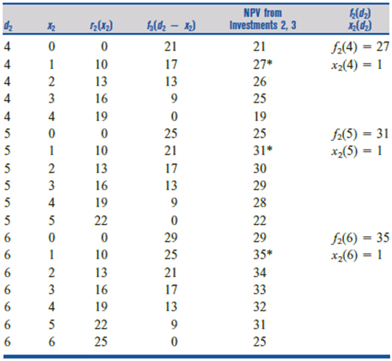
Stage 2 cont...

Slide 26
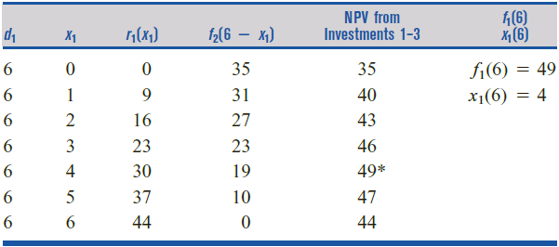
Resource-Allocation Problems
max { r₁(d₁) + r₂(d₂) + r₃(d₃) }
s.t. d₁ + d₂ + d₃ = 6 , d_{j} > 0 for j = 1, 2, 3
Stage 1: Invest on all 3 invesment with 6k
f₁(6) = max {r₁(x₁) + f₂(6 – x₁)}

Slide 27


Knapsack Problems
Maximize total benefit of a 10-lb knapsack which to be filled with the items listed below.
Item | Weight (lb) | Benefit
1 | 4 | 11
2 | 3 | 7
3 | 5 | 12
Item | g(x) | r(x)
x₁ | 4x₁ | 11x₁
x₂ | 3x₂ | 7x₂
x₃ | 5x₃ | 12x₃
Stage 3:
f₃(d) = max_{x} {12x₃}
Total weight available

Slide 28
Knapsack Problems
Item | Weight | Benefit
x₁ | 4 | 11
x₂ | 3 | 7
x₃ | 5 | 12
Maximum 10-lb knapsack
Stage 3:
5x₃ ≤ d
x₃(10) = 2 units f₃(10) = 12(2) = 24
x₃(9) = x₃(8) = x₃(7) = x₃(6) = x₃(5) = 1 unit
f₃(9) = f₃(8) = f₃(7) = f₃(6) = f₃(5) = 12(1) = 12
x₃(4) = x₃(3) = x₃(2) = x₃(1) = x₃(0) = 0 unit
f₃(4) = f₃(3) = f₃(2) = f₃(1) = f₃(0) = 12(0) = 0

Slide 29
Knapsack Problems
Item | Weight | Benefit
x₁ | 4 | 11
x₂ | 3 | 7
f₃(10) = 24
f₃(5) = f₃(6) = f₃(7) = f₃(8) = f₃(9) = 12
f₃(0) = f₃(1) = f₃(2) = f₃(3) = f₃(4) = 0
Stage 2:
3x₂ ≤ d, f₂(d) = max_{x}{7x₂ + f₃(d – 3x₂)}
d | x₂ | 7x₂ | f₃(d – 3x₂) | Total | f₂(d) x₂
10 | 0 | 0 | f₃(10) = 24 | 24 | f₃(10) = 24
10 | 1 | 7 | f₃(7) = 12 | 19 | x₂ = 0
10 | 2 | 14 | f₃(4) = 0 | 14
10 | 3 | 21 | f₃(1) = 0 | 21
9 | 0 | 0 | f₃(9) = 24 | 12 | f₃(9) = 21
9 | 1 | 7 | f₃(6) = 12 | 19 | x₂ = 3
9 | 2 | 14 | f₃(3) = 0 | 14
9 | 3 | 21 | f₃(0) = 0 | 21

Slide 30
Knapsack Problems
Item | Weight | Benefit
x₁ | 4 | 11
x₂ | 3 | 7
f₃(10) = 24
f₃(5) = f₃(6) = f₃(7) = f₃(8) = f₃(9) = 12
f₃(0) = f₃(1) = f₃(2) = f₃(3) = f₃(4) = 0
Stage 2: cont…
3x₂ ≤ d, f₂(d) = max_{x}{7x₂ + f₃(d – 3x₂)}
d | x₂ | 7x₂ | f₃(d – 3x₂) | Total | f₂(d) x₂
8 | 0 | 0 | f₃(8) = 24 | 12 | f₃(8) = 19
8 | 1 | 7 | f₃(5) = 12 | 19 | x₂ = 1
8 | 2 | 14 | f₃(2) = 0 | 14
7 | 0 | 0 | f₃(7) = 0 | 12 | f₃(7) = 14
7 | 1 | 7 | f₃(4) = 24 | 7 | x₂ = 2
7 | 2 | 14 | f₃(1) = 12 | 14
6 | 0 | 0 | f₃(6) = 12 | 12 | f₃(6) = 14
6 | 1 | 7 | f₃(3) = 0 | 7 | x₂ = 2
6 | 2 | 14 | f₃(0) = 0 | 14

Slide 31
Knapsack Problems
Item | Weight | Benefit
x₁ | 4 | 11
x₂ | 3 | 7
f₃(10) = 24
f₃(5) = f₃(6) = f₃(7) = f₃(8) = f₃(9) = 12
f₃(0) = f₃(1) = f₃(2) = f₃(3) = f₃(4) = 0
Stage 2: cont…
3x₂ ≤ d, f₂(d) = max_{x}{7x₂ + f₃(d – 3x₂)}
d | x₂ | 7x₂ | f₃(d – 3x₂) | Total | f₂(d) x₂
5 | 0 | 0 | f₃(5) = 12 | 12 | f₃(5) = 12
5 | 1 | 7 | f₃(2) = 0 | 7 | x₂ = 1
4 | 0 | 0 | f₃(4) = 0 | 0 | f₃(4) = 7
4 | 1 | 7 | f₃(1) = 0 | 7 | x₂ = 1
3 | 0 | 0 | f₃(3) = 0 | 0 | f₃(3) = 0
3 | 1 | 7 | f₃(0) = 0 | 7 | x₂ = 1
2 | 0 | 0 | f₃(2) = 0 | 0 | f₃(2) = 0
1 | 0 | 0 | f₃(1) = 0 | 0
0 | 0 | 0 | f₃(0) = 0 | 0

Slide 32
Knapsack Problems
Item | Weight | Benefit
x₁ | 4 | 11
Stage 1:
4x₁ ≤ 10, f₁(d) = max_{x}{11x₂ + f₂(d – 4x₁)}
Hence, we should include one Type 1 item in the knapsack. Then we have 10 − 4 = 6 lb left for Type 2 and Type 3 items, so we should include x₂(6) = 2 Type 2 items. Finally, we have 6 − 2(3) = 0 lb left for Type 3 items, and we include x₃(0) = 0 Type 3 items. In summary, the maximum benefit that can be gained from a 10-lb knapsack is f₃(10) = 25. To obtain a benefit of 25, one Type 1 and two Type 2 items should be included.
d | x₁ | 11x₁ | f₂(d – 4x₁) | Total | f₁(d) x₁
10 | 0 | 0 | f₂(10) = 24 | 24 | f₁(10) = 25
10 | 1 | 11 | f₂(6) = 14 | 25 | x₁ = 1
10 | 2 | 22 | f₂(2) = 0 | 22

Slide 33

Equipment-Replacement Problems
An auto repair shop always needs to have an engine analyzer available. A new engine analyzer costs $1,000. The cost m_{i} of maintaining an engine analyzer during its i^{th} year of operation incurred. An analyzer may be kept for 1,.2,.or.3.years; after i years of use (i = 1, 2, 3), it may be traded in for a new one. If an i-year-old engine analyzer is traded in, a salvage value s_{i} is obtained. Given that a new machine must be purchased now (time 0), the shop wants to determine a replacement and trade-in policy that minimizes net costs (maintenance costs) + (replacement costs) – (salvage value received) during the next 5 years.
Year | Maintenance cost | Salvage value
1 | 60 | 800
2 | 80 | 600
3 | 120 | 500

Slide 34
Equipment-Replacement Problems
Year | m_{i} | s_{i}
1 | 60 | 800
2 | 80 | 600
3 | 120 | 500
t = new machine purchased time,
x = machine operating year before replacement
** t + 1 ≤ x ≤ t + 3 (t = 0, 1, …, 4) , x ≤ 5
Total cost incurred To time 5: g(t) = min_{x} {c_{tx} + g(x)}
1 year of usage: c₀₁ = c₁₂ = c₂₃ = c₃₄ = c₄₅ = 1000 + 60 – 800 = 260
2 years of usage: c₀₂ = c₁₃ = c₂₄ = c₃₅ = 1000 + 60 + 80 – 600 = 540
3 years of usage: c₀₃ = c₁₄ = c₂₅ = 1000 + 60 +80 + 120 – 500 = 760
Stage 5: g(5) = 0
Stage 4: g(4) = c₄₅ + g(5) = 260 + 0 = 260

Slide 35
Equipment-Replacement Problems
t = machine purchased time,
x = machine operating year before replacement
** t + 1 ≤ x ≤ t + 3, x ≤ 5
new Total cost incurred to time 5: g(t) = min_{x} {c_{tx} + g(x)}
1 year of usage: c₀₁ = c₁₂ = c₂₃ = c₃₄ = c₄₅ = 1000 + 60 – 800 = 260
2 years of usage: c₀₂ = c₁₃ = c₂₄ = c₃₅ = 1000 + 60 + 80 – 600 = 540
Stage 3: g(3) =

Slide 36
Equipment-Replacement Problems
1 year of usage: c₀₁ = c₁₂ = c₂₃ = c₃₄ = c₄₅ = 1000 + 60 – 800 = 260
2 years of usage: c₀₂ = c₁₃ = c₂₄ = c₃₅ = 1000 + 60 + 80 – 600 = 540
3 years of usage: c₀₃ = c₁₄ = c₂₅ = 1000 + 60 +80 + 120 – 500 = 760
Stage 2:
g(2) =
Stage 1:
g(1) =

Slide 37
Equipment-Replacement Problems
1 year of usage: c₀₁ = c₁₂ = c₂₃ = c₃₄ = c₄₅ = 1000 + 60 – 800 = 260
2 years of usage: c₀₂ = c₁₃ = c₂₄ = c₃₅ = 1000 + 60 + 80 – 600 = 540
3 years of usage: c₀₃ = c₁₄ = c₂₅ = 1000 + 60 +80 + 120 – 500 = 760
Stage 0:
g(0) =
new machine purchased at time 0 should be replaced at time 1 or time 3. With this replacement policy, we will incur a net cost of g(0) = $1,280. Optimal replacement policies:
(1) trading in at times 1, 2, and 5 and (2) trading in at times 1, 4, and 5 and
(3) trading in at times 3, 4, and 5.

Slide 38
Formulating Dynamic Programming Recursions
f_{t}(i) = min{cost during state t + f_{t+1}(new state at stage t+1)}
Aspect 1
The set of decisions that is allowable, or feasible, for the given state and stage
Aspect 2
We must specify how the cost during the current time period (stage t) depends on the value of t, the current state, and the decision chosen at stage t
Aspect 3
We must specify how the state at stage t + 1 depends on the value of t, the state at stage t, and the decision chosen at stage t

Slide 39
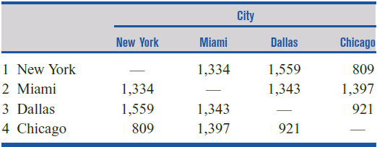
Traveling Salesman
Walter Glenn is in New York City. Before election day, Walter must visit Miami, Dallas, and Chicago and then return to his New York City headquarters. Walter wants to minimize the total distance he must travel. In what order should he visit the cities?

Slide 40
Traveling Salesman
3. Dallas
4. Chicago
2. Miami
4. Chicago
3. Dallas
2. Miami
4. Chicago
1. NY
3. Dallas
1. NY
4. Chicago
2. Miami
2. Miami
3. Dallas
4. Chicago
3. Dallas
2. Miami

Slide 41
Traveling Salesman
Stage concern:
Current city
Cities has been visited, S
Every states consists:
Last city visited, i
Cities has been visited
f₄(i, S) = min distance if t – 1 cities in the set S
c_{ij} be the distance between cities i and j
Stage 4: f₄(i, S)
f₄(2, {3, 4}) = c₂₁ = 1,334*
f₄(3, {2, 4}) = c₃₁ = 1,559*
f₄(4, {2, 3}) = c₄₁ = 809*

Slide 42
Traveling Salesman
Stage 3: f₃(i, S) = {c_{ij} + f₄(j, S) }
f₃(2, {3}) = c₂₄ + f₄(4, {2, 3}) = 1397 + 809 = 2206*
f₃(2, {4}) = c₂₃ + f₄(3, {2, 4}) = 1343 + 1559 = 2902*
f₃(3, {2}) = c₃₄ + f₄(4, {2, 3}) = 921 + 809 = 1730*
f₃(3, {4}) = c₃₂ + f₄(2, {3, 4}) = 1343 + 1334 = 2677*
f₃(4, {2}) = c₄₃ + f₄(3, {2, 4}) = 921 + 1559 = 2480*
f₃(4, {3}) = c₄₂ + f₄(2, {3, 4}) = 1397 + 1334 = 2731*
f₄(2, {2, 3, 4}) = c₂₁ = 1,334
f₄(3, {2, 3, 4}) = c₃₁ = 1,559
f₄(4, {2, 3, 4}) = c₄₁ = 809

Slide 43
Traveling Salesman
Stage 2: f₂(i, S) = {c_{ij} + f₃(j, S) }
f₂(2) = min
f₂(3) = min
f₂(4) = min
f₃(2, {3}) = c₂₄ + f₄(4, {2, 3}) = 2206
f₃(2, {4}) = c₂₃ + f₄(3, {2, 4}) = 2902
f₃(3, {2}) = c₃₄ + f₄(4, {2, 3}) = 1730
f₃(3, {4}) = c₃₂ + f₄(2, {3, 4}) = 2677
f₃(4, {2}) = c₄₃ + f₄(3, {2, 4}) = 2480
f₃(4, {3}) = c₄₂ + f₄(2, {3, 4}) = 2731
c₂₃ + f₃(3, {2}) = 1343 + 1730 = 3073*
c₂₄ + f₃(4, {2}) = 1397 + 2480 = 3877
c₃₂ + f₃(4, {3}) = 1343 + 2206 = 3549*
c₃₄ + f₃(2, {3}) = 921 + 2731 = 3652
c₄₂ + f₃(2, {4}) = 1397 + 2902 = 4299
c₄₃ + f₃(3, {4}) = 921 + 2677= 3598*

Slide 44
Traveling Salesman
Stage 1: f₁(i, S) = {c_{ij} + f₃(j, S) }
f₁(1) = min
Optimal solution:
NY → Miami → Dallas → Chicago → NY
or
NY → Chicago → Dallas → Miami→ NY
f₂(2) = c₂₃ + f₃(3, {2}) = 3073
f₂(3) = c₃₂ + f₃(4, {3}) = 3549
f₂(4) = c₄₃ + f₃(3, {4}) = 3598
c₁₂ + f₂(2, {1}) = 1343 + 3703 = 4407*
c₁₃+ f₂(3, {1}) = 1559 + 3549 = 5108
c₁₄+ f₂(4, {1}) = 809 + 3598 = 4407*

Slide 45
Non-additive Recursion

Slide 46
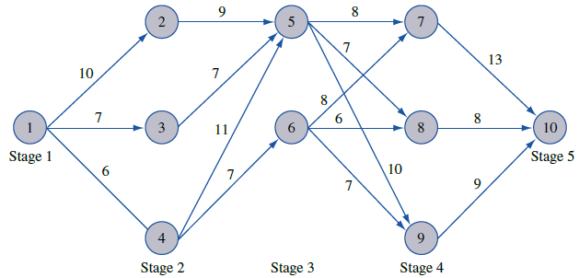
Minimax Shortest Route
Joe wants to minimize the maximum altitude above sea level that he will encounter during his drive.

Slide 47
Minimax Shortest Route
f₄(7) = 13*
f₄(8) = 8*
f₄(9) = 9*

Slide 48
Minimax Shortest Route
f₂ (2)= max [c₂₅, f₃(5)] = 9*
f₂ (3)= max [c₃₅, f₃(5)] = 8*
Optimal path:
1 – 3 – 5 – 8 – 10
1 – 4 – 6 – 8 – 10

Slide 49
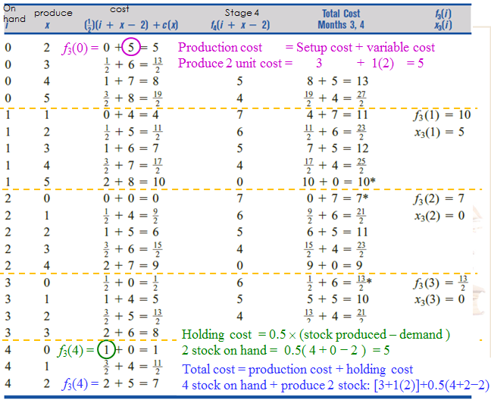
Wagner – Whitin Algorithm
Dynamic Lot-Size Model
Determine an optimal production schedule for a 5-period dynamic lot-size model with fixed cost, K = $250, production cost, c = $2, holding cost, h = $1, demand, d₁ = 220, d₂ = 280, d₃ = 360, d₄ = 140, and d₅ = 270. Assume that the initial inventory level is zero.
** if use backward method:
Possible states at Stage 2:
d₂ + d₃ + d₄ + d₅ = 280 + 360 + 140 + 270 = 1050
f₂(0) , f₂(1) , f₂(2) , … , f₂(1050)
WWA recursion : min cost incurred during period t, t+1, …T with 0 beginning inventory at each period
f_{t} = min_{j=0…T-t} (c_{ij} + f_{t+j+1})
calculation is long…
Remember?
Inventory Problem

Slide 50
Wagner – Whitin Algorithm
Dynamic Lot-Size Model
K = $250, c = $2, h = $1
d₁ = 220, d₂ = 280, d₃ = 360, d₄ = 140, and d₅ = 270
f_{t} = min_{j=0…T-t} (c_{ij} + f_{t+j+1})
f₆ = 0
f₅ = K + c(d₅) + h(0) = 250 + 2(270) + 0 = 790*
Produce 2 months product,
holding Month 5’s product for 1 month
Notes:
when begin with zero inventory in period 4, we should produce enough to meet the demand of period 4 (d₄= 140 units) ONLY

Slide 51
Wagner – Whitin Algorithm
Dynamic Lot-Size Model
K = $250, c = $2, h = $1
d₁ = 220, d₂ = 280, d₃ = 360, d₄ = 140, and d₅ = 270
Produce 3 months product,
holding Month 4’s product for 1 month
holding Month 5’s product for 2 months
Notes:
f₃ last eqn: ‘1’ and ‘2’ represent the holding costs, where ‘2’ represents the holding cost of d₅ units for 2 periods (which equals to 2 × $1)

Slide 52

Wagner – Whitin Algorithm
Dynamic Lot-Size Model
K = $250, c = $2, h = $1
d₁ = 220, d₂ = 280, d₃ = 360, d₄ = 140, and d₅ = 270
a = 220 + 280 + 360 + 140
b = 220 + 280 + 360 + 140 + 270
the variable production costs can be ignored to simplify the calculations
Optimal Solution: Produce 220 at Month 1, Produce 280 at Month 2, Produce (360 + 140) at Month 3, Produce 0 at Month 4, and Produce 270 at Month 5, with cost $3680
Still calculation is long…

Slide 53
Silver – Meal Heuristic
Determine the average cost per period as a function of the number of periods the current order is to span and STOP the computation when this function first increases.
TC(t) = K + HC(t)
= K + [ hd₂ + 2hd₃ + … + (t − 1)hd_{t} ]
AC(t + 1) > AC(t) STOP!!
Notes:
d_{t} = demand during period t
h = holding cost per unit
K = Setup Cost
HC(t) = Holding Cost incurred during the next t period
TC(t) = Total Cost will be incurred ( ignore variable production cost)
AC(t) = Average Cost

Slide 54
Silver – Meal Heuristic
Start from period t* | Carry to next period | TC(t) | AC(t)
1 | 1 (current) | 250 + 0 = 250
 | 2 (month 2) | 250 + 1(280) = 530
2 | 1(current) | 250 + 0 = 250
 | 2 (month 3) | 250 + 1(360) = 610
3 | 1 (current) | 250 + 0 = 250
 | 2 (month 4) | 250 + 1(140) = 390
 | 3 (month 5) | 250 + 1(140) + 2(270) = 930
4 | - | - | -
5 | - | 250 | -
AC(2) > AC(1) stop!!
optimal solution has cost:
$(250 + 250 + 390 + 250) = $1140 (without production cost)
After add up the production cost,
1140 + 2(220+280+360+140+270) = $ 3680
AC(2) > AC(1) stop!!
AC(2) < AC(1) continue
AC(3) > AC(2) stop!!
Optimal Solution

